Slide 1
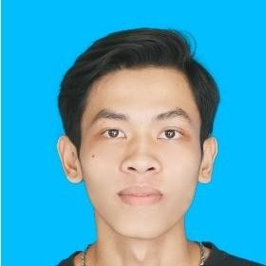
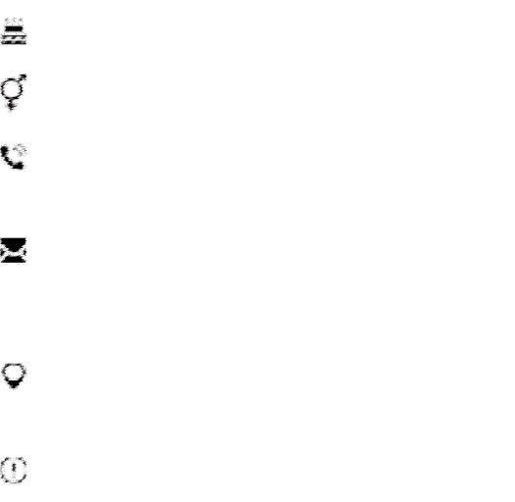
PROJECT
FaHaSa Management System
Team project (Backend). 09/2021 - 10/2021 (2 months)
-GitHub:https://github.com/hiep1512001/Fahasa-management- system
-Descripsion: Users can manage products including purchases and sales in their store through reports. There is also an employee attendance feature.
-Detail: C#.NET, SQL Server, Entity Framework, GunaUI.
NGUYỄN HOÀNG HIỆP
DEVELOPER DOT NET
INFORMATION
15/01/2001
male
Yame Management System
Team project (Backend) 09/2021 - 10/2021 (2 months)
0812356946
nguyenhoanghiep1512001@gmail.
-GitHub:https://github.com/hiep1512001/Yame-management- system
-Descripsion: Users can manage products including purchases and sales in their store through reports. There is also an employee attendance feature.
-Detail: C#.NET, SQL Server, Entity Framework, GunaUI.
com
450 Le Van Viet, District 9, Ho Chi
Minh, Vietnam
https://github.com/hiep1512001
SUMMARY
WEB MUSIC INTEGRATE SONG SUGGESTION FUNCTION
Pesonal project (FullStack)
04/2023 - 07/2023 (3 months)
As a 4th year student majoring in Information Technology at UTC-HCMC, I have knowledge of OOP, algorithmic and data structures, software development and understand some programming languages such as C#.NET, JavaScript, Java, C/C++,... My goal is to give people a better life by developing technology solutions.
-GitHub: https://github.com/hiep1512001/DATN_WebMusic_Recommender_system
-Descripsion: Web music has functions to serve users in terms of listening to music, creating playlists, searching,...Admin tools to manage songs, singers, genres,...Song suggestion system based on two techniques are collaborative filtering and content-based filtering.
-Detail: ASP.NET MVC, Entity Framework, SQL Server, Bootstrap, Ajax, ML.Net,Facebook api,....
SKILL
- C# .Net: Winform, ASP.NET MVC.
- Html, css: Design web layouts, format html tags with css.
- JavaScript: proficient at the basic level.
- Bootstrap: use components, build layouts
- Database SQL Server, Oracle database.
- English: basic level.
- Git.
- Enthusiastic, diligent, eager to learn.
EDUCATION
-Bachelors - University Of Transport And Communications In Ho Chi Minh City 09/2019 - 07/2023 (3 years 11 months)
- GPA: 3.37/4.0
- Scholarship In 1st Semester 2019-2020, 2nd Semester 2019-2020, 1st Semester 2020-2021, 2nd Semester2020-2021 and 1st 2022-2023

